Slide 1
Game Physics
CMPS 499
Game Algorithms & Engine Architecture
Dr. Ashok Kumar

Slide 2
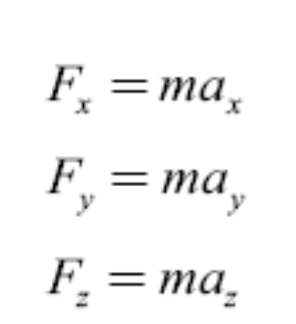
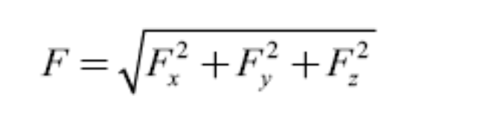
Force
Force is a vector quantity in that a force has both a magnitude and a direction.
F = ma
A force vector is split into directional components being used.

Slide 3



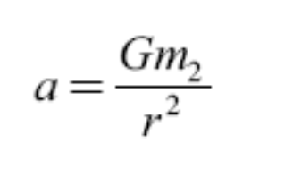
Gravitational Force
There is a gravitational force F_{G} between any two objects
G =

Slide 4
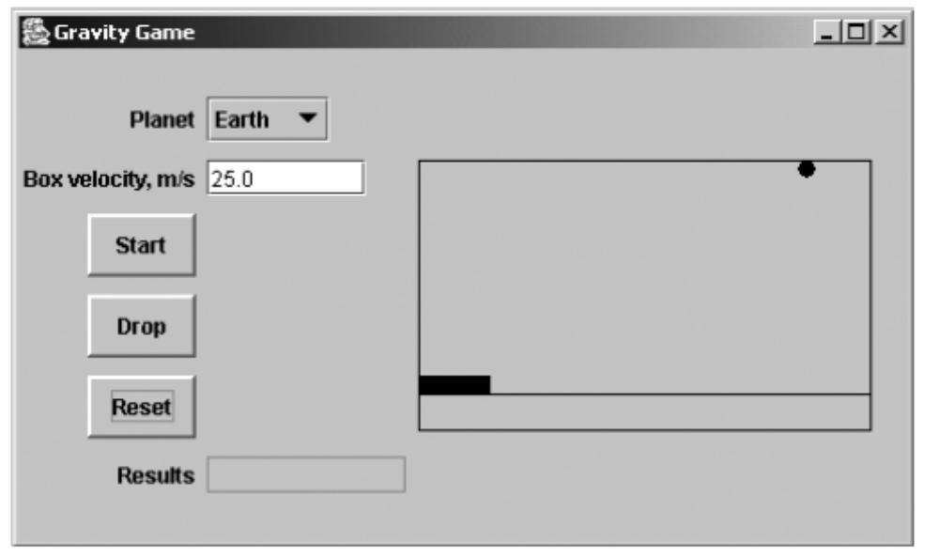
Gravity Game

Slide 5
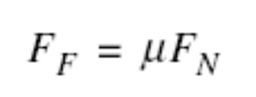
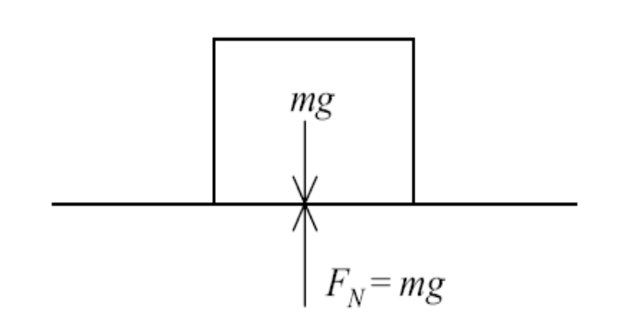
Frictional Force
Friction is the force that resists motion between two contacting surfaces.
It is proportional to the normal force between the contacting surfaces. The normal force exerted by an object is the component of the force vector normal, that is perpendicular, to the surface that is in contact with the object.

Slide 6
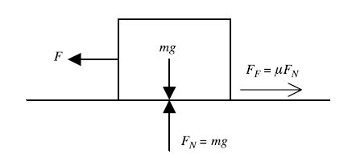
Frictional Force Acts in Opposite Direction of Applied Force

Slide 7
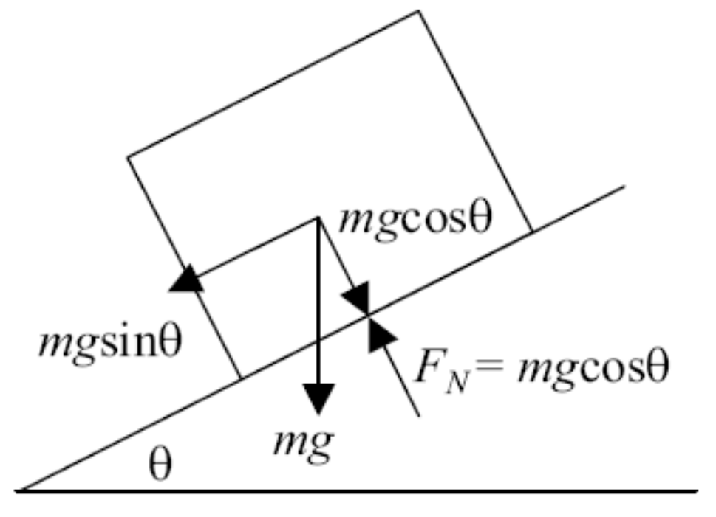
Frictional Force (contd.)

Slide 8
Frictional Force (contd.)
When modeling the effects of friction, two coefficients of friction must be taken into account.
When the objects are motionless, the coefficient of static friction, µ_{s}, governs the frictional force.
When the objects begin to slide, the friction between them usually decreases, and the frictional force is defined by the coefficient of kinetic friction, µ_{k}.

Slide 9
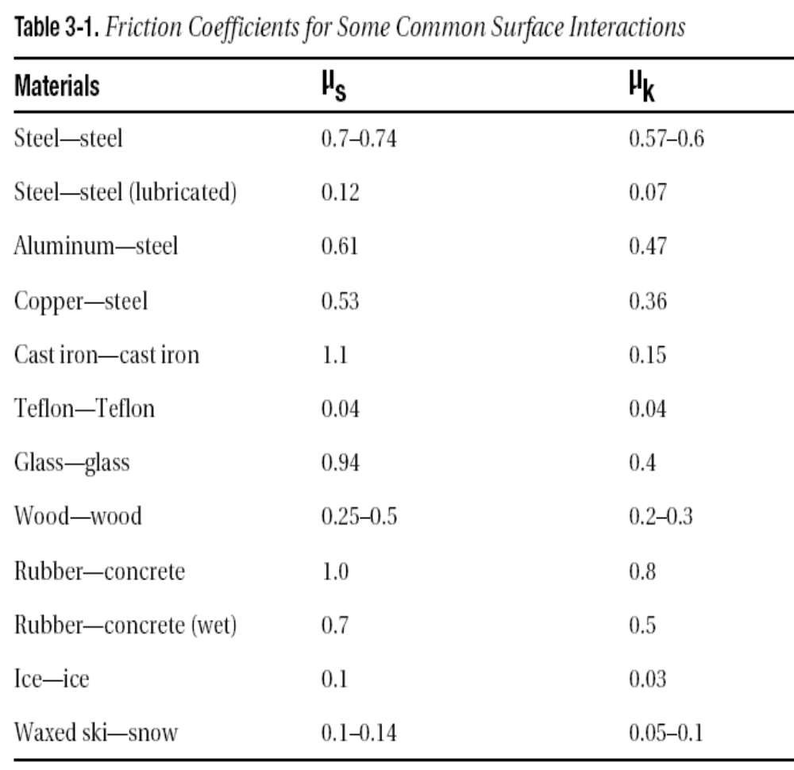
Frictional Force (contd.)

Slide 10
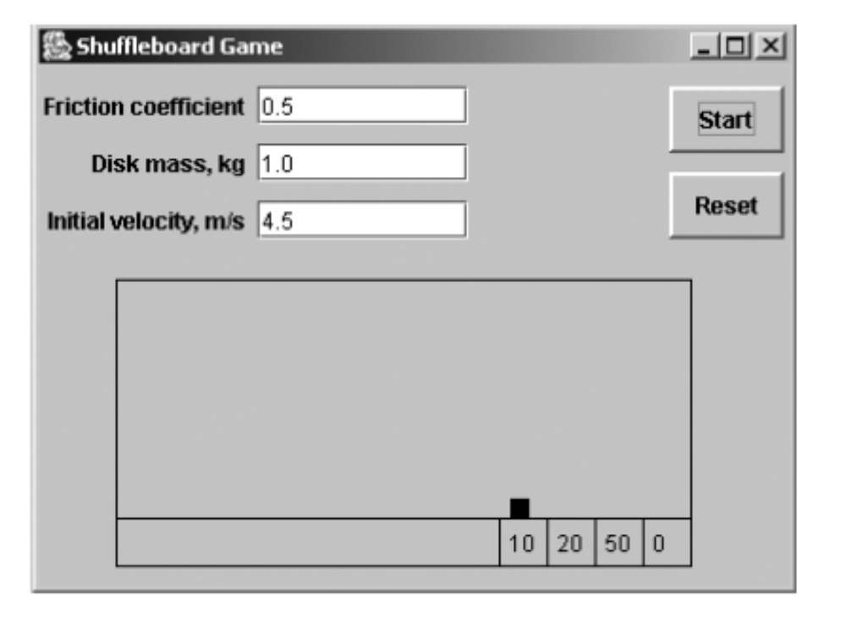
Frictional Force (contd.)

Slide 11
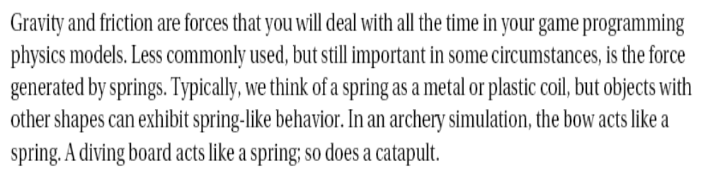
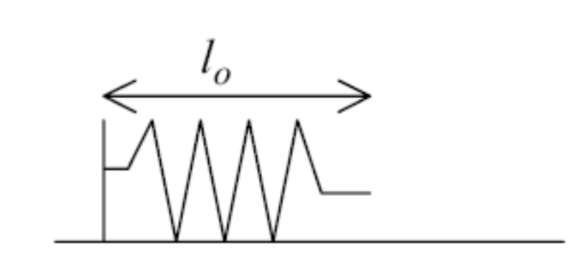
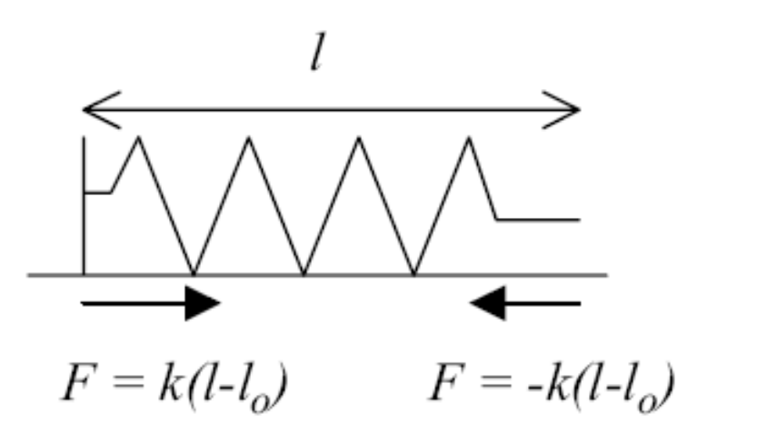
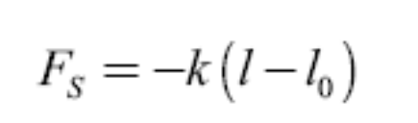

Spring

Slide 12
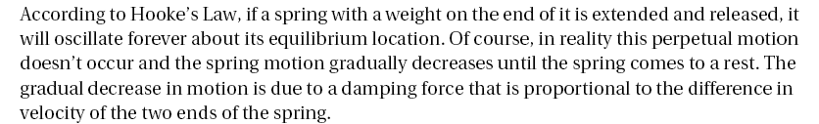
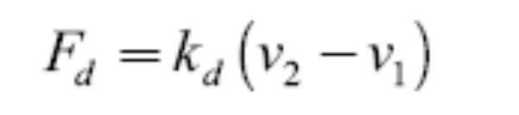
Damping Force of a Spring

Slide 13
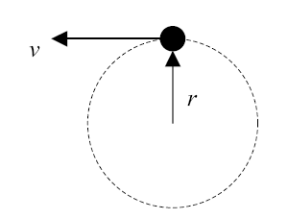
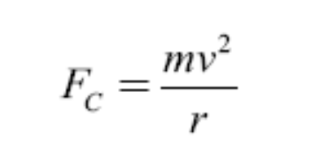
Centripetal Force

Slide 14
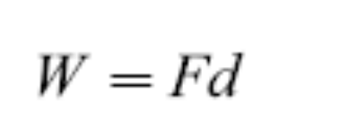
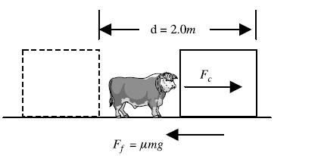
Work
In terms of physics, work is performed when a force, F, is applied to an object over a distance, d.

